Slide 1

MINDFUL MONITOR
By
Eeda Gunavardhan
CSE – Data Science
CVR College of Engineering, Hyderabad

Slide 2
Problem statement
Inappropriate content found online poses a risk, especially to vulnerable individuals like children.
A software tool that has been developed to continuously monitor desktop screens for obscene or inappropriate content and provide real-time alerts to users can help us get rid of this risk.

Slide 3
Benefits of this tool
The software continuously monitors desktop screens for inappropriate content and alerts users when any obscene or inappropriate content is detected.
The software provides a way for schools to monitor and protect their students by detecting any inappropriate content that may appear on their screens.
For parents, the software can provide peace of mind by allowing them to monitor their children's computer use and protect them from inappropriate content.
The software promotes safer and more responsible use of technology, potentially making a significant impact on the way we use and interact with technology in our daily lives.

Slide 4
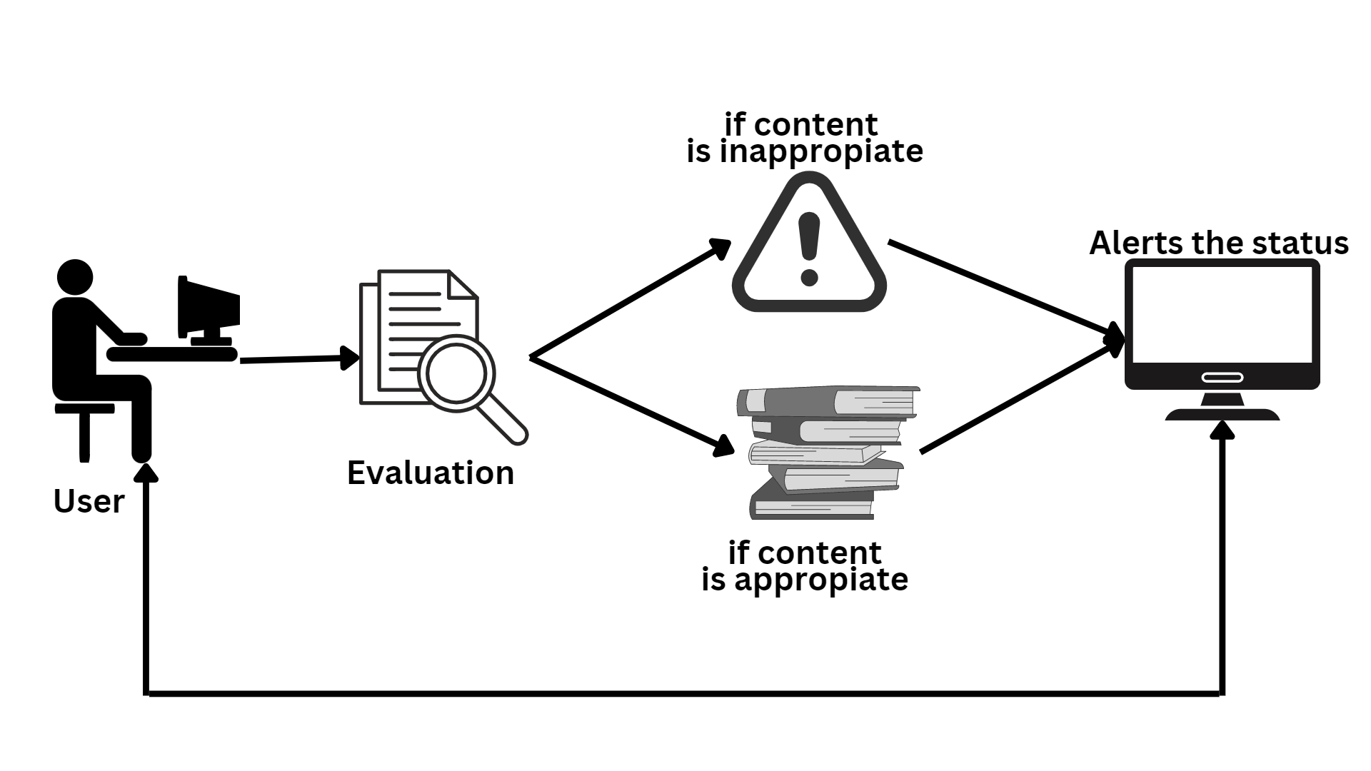
Flow Diagram

Slide 5
Demo execution

Slide 6
Enhancements
Multi-language support
Integration with other software
Offline monitoring

Slide 7
Resources
Python
OpenCV
Time
Pytesseract
Tkinter
Google Cloud Vision

Slide 8

Any Queries?

Slide 9

Thank You

